Slide 1
Population Dynamics
Challenges and Opportunities
Dr. Tanja Kiziak
Berlin Institute for Population and Development

Slide 2
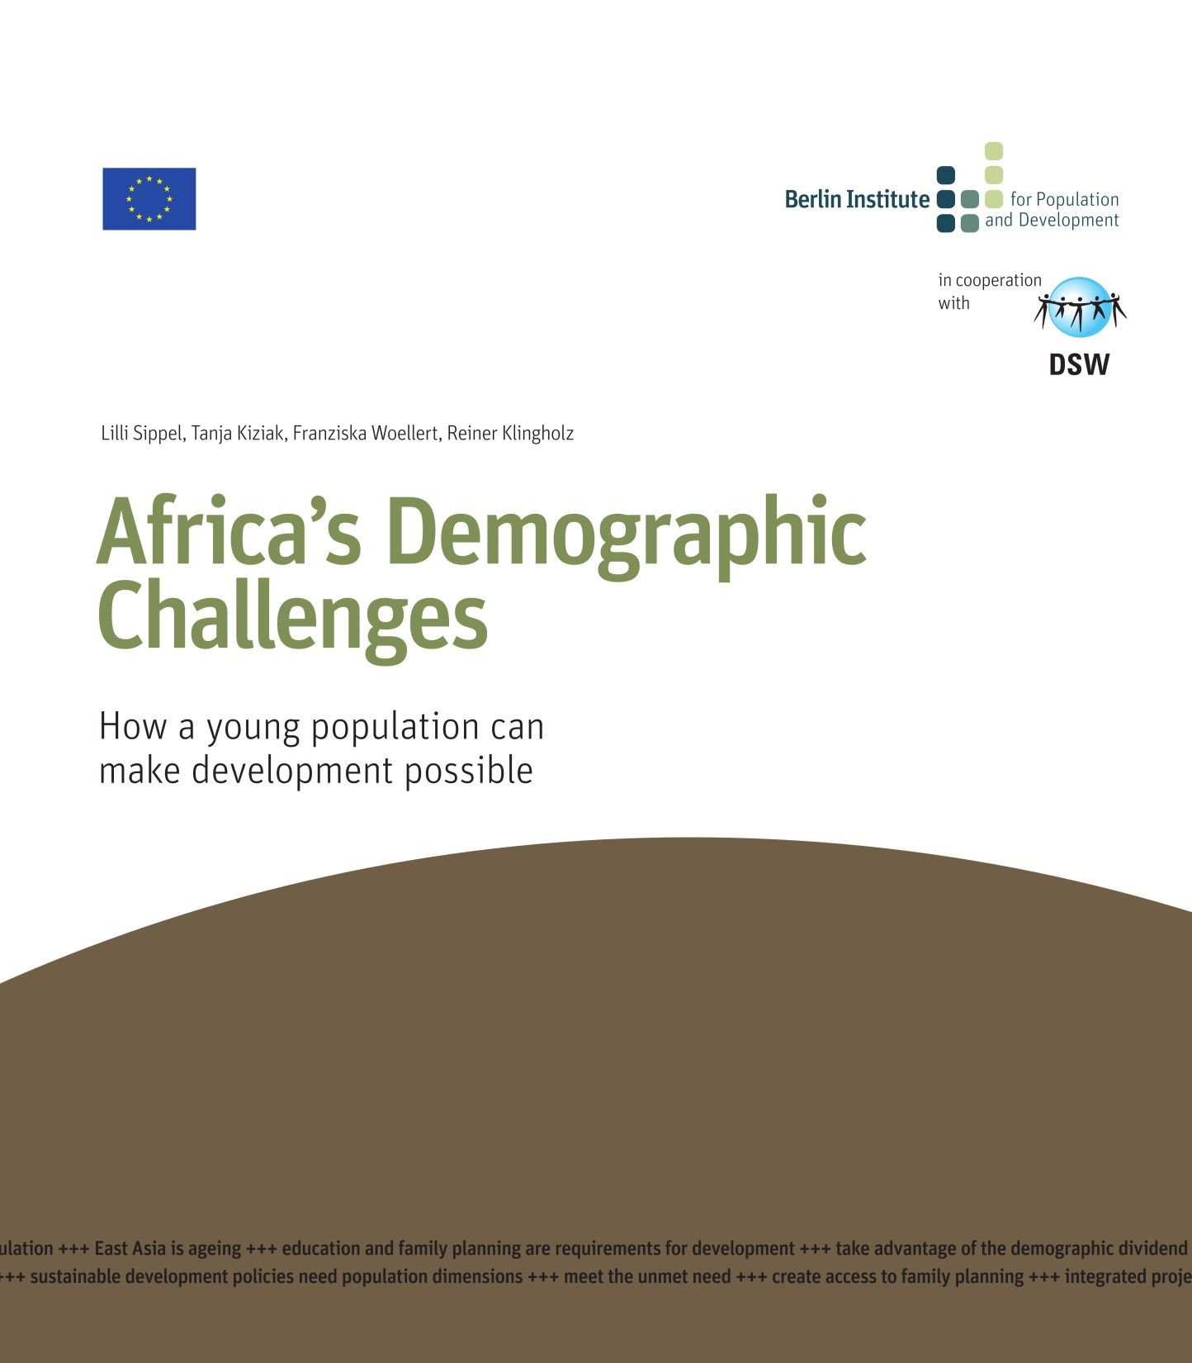

Slide 3
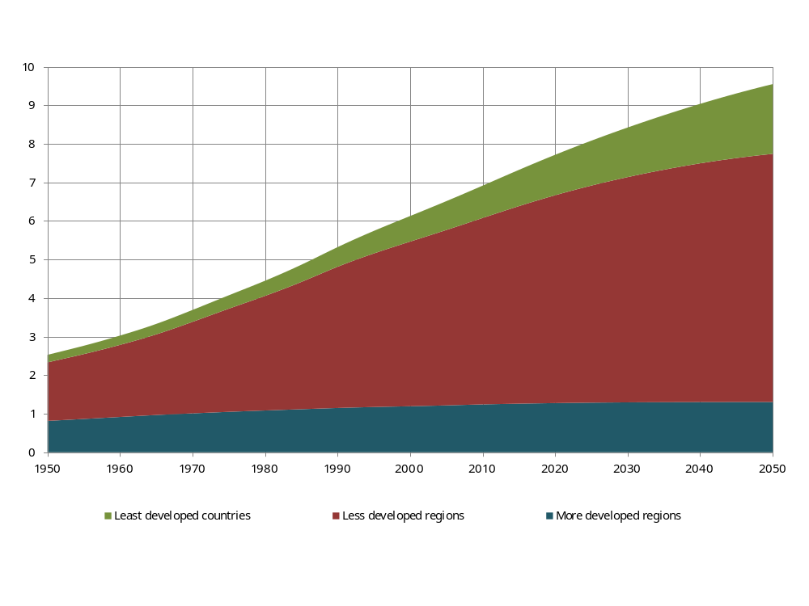
World population in billions, medium variant, by type of country
Data: United Nations

Slide 4
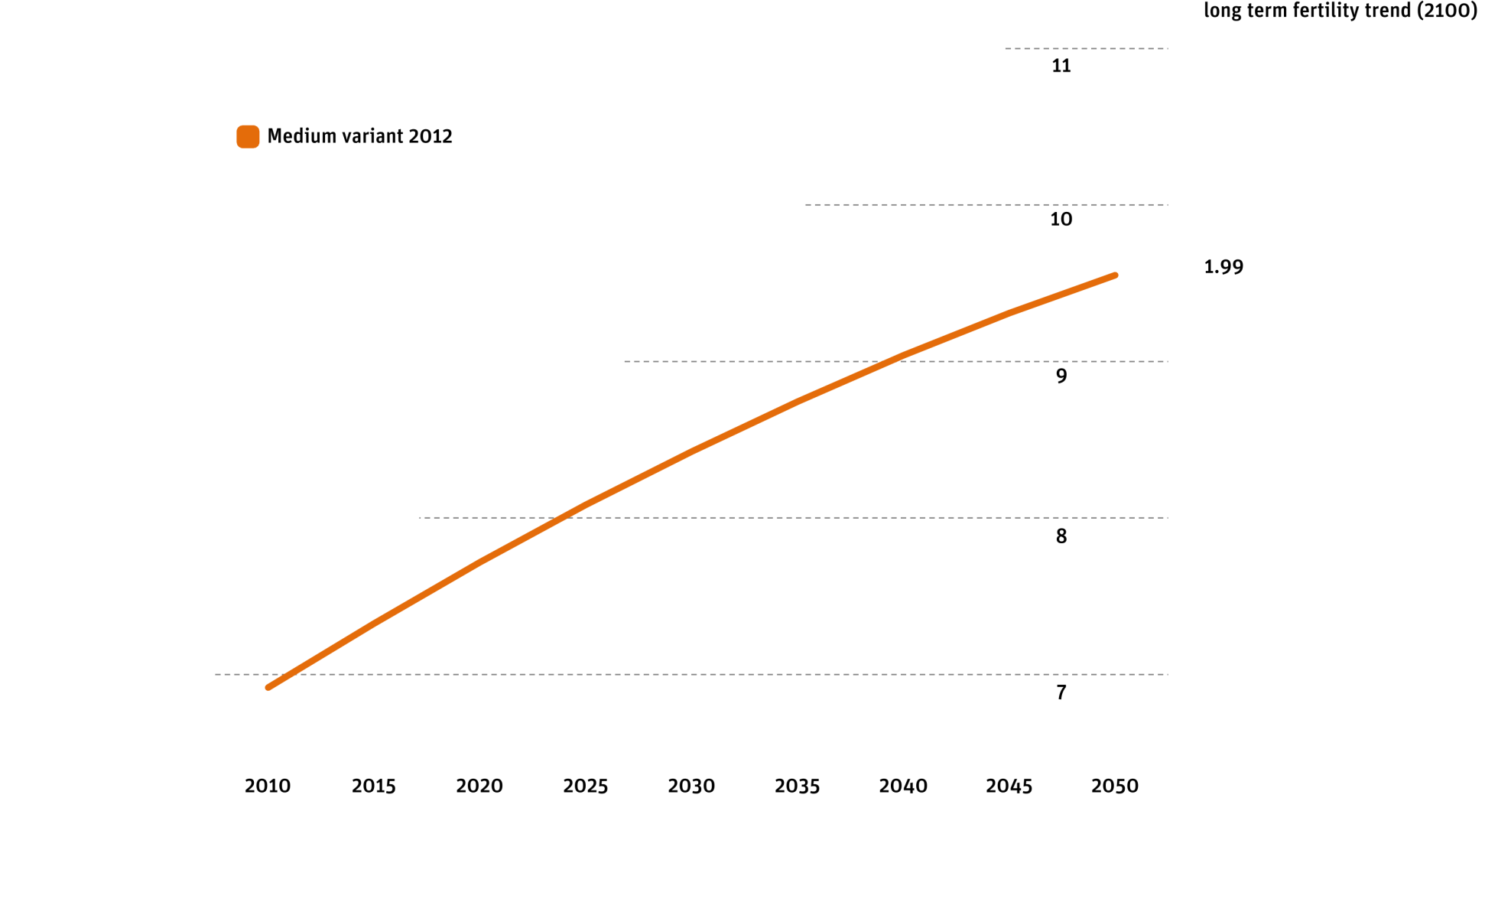
United Nations Population Prospect in different variants, in billions
Data: United Nations

Slide 5
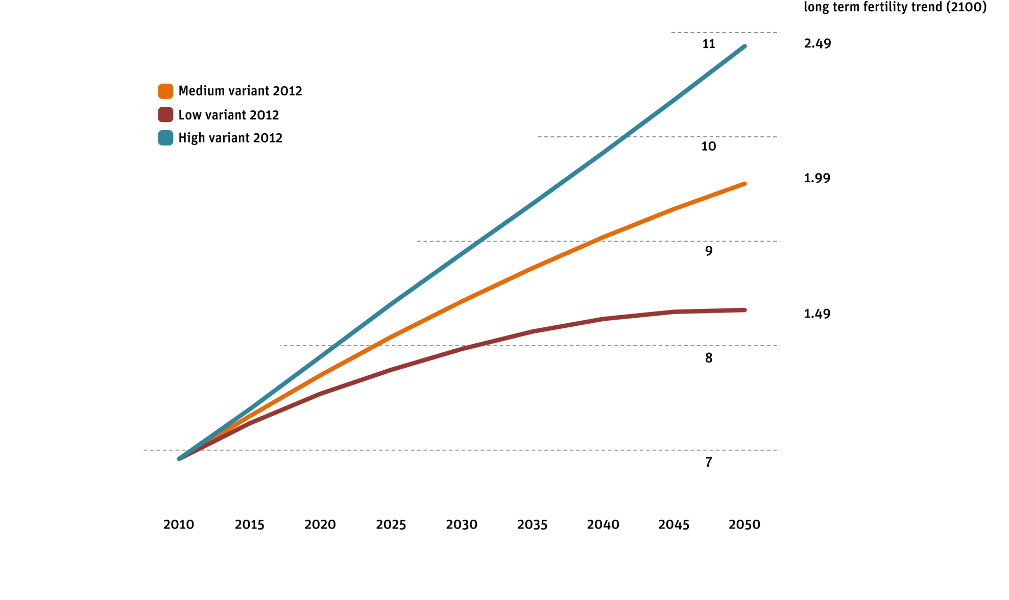
United Nations Population Prospect in different variants, in billions
Data: United Nations

Slide 6
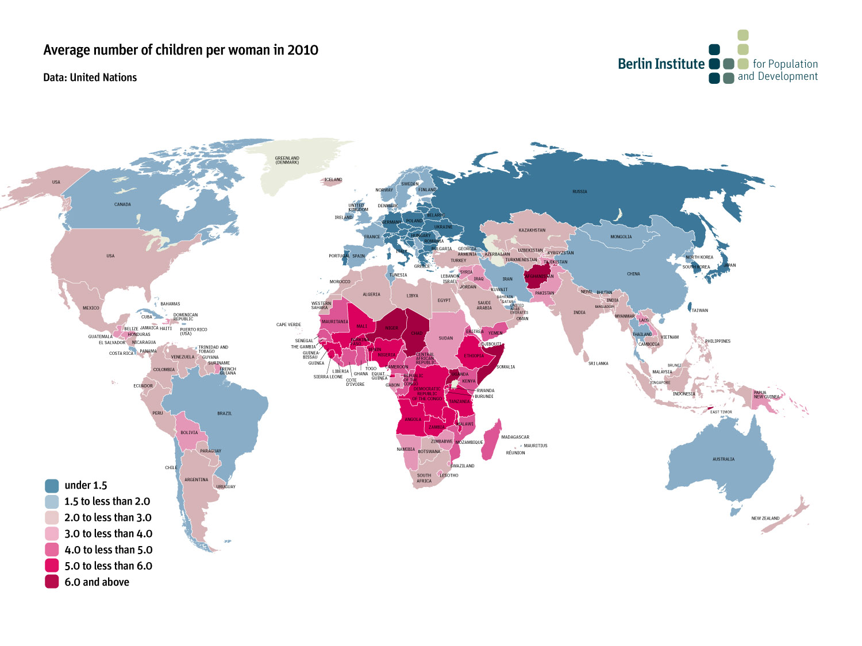


Slide 7
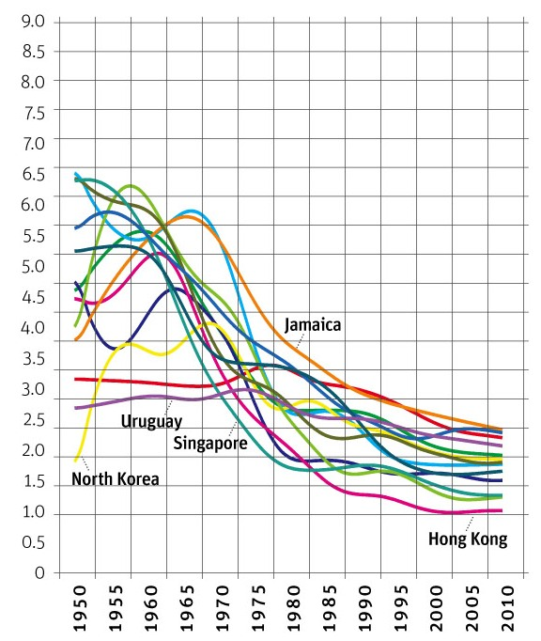
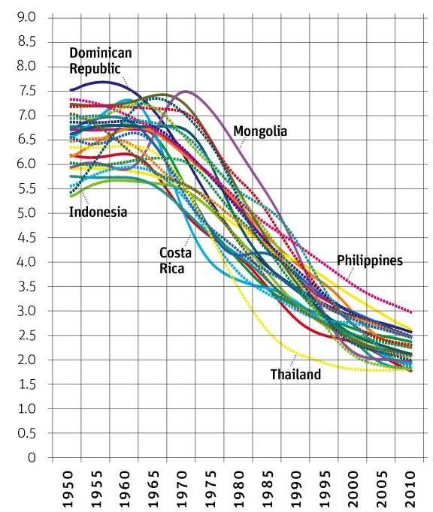

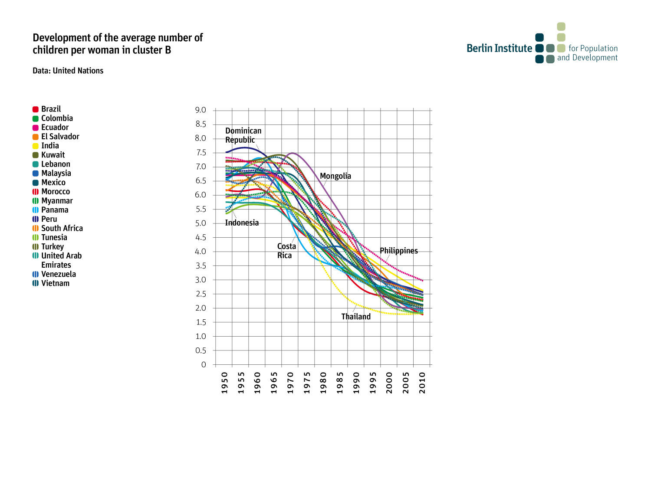
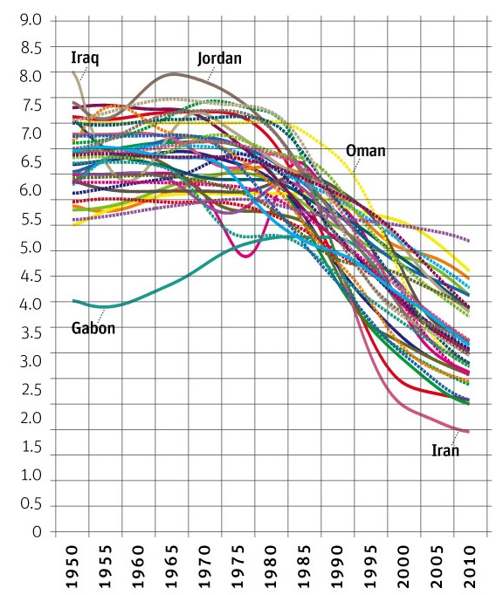
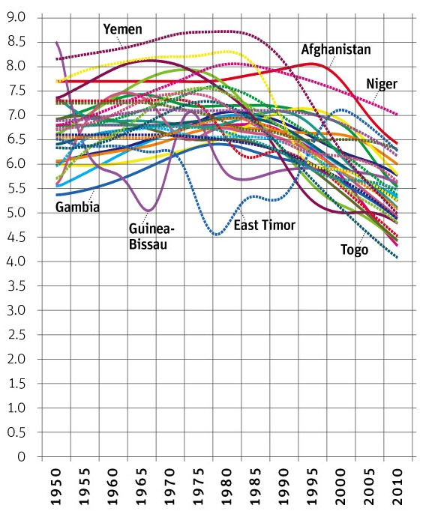
Cluster A
Cluster B
Cluster C
Cluster D

Slide 9
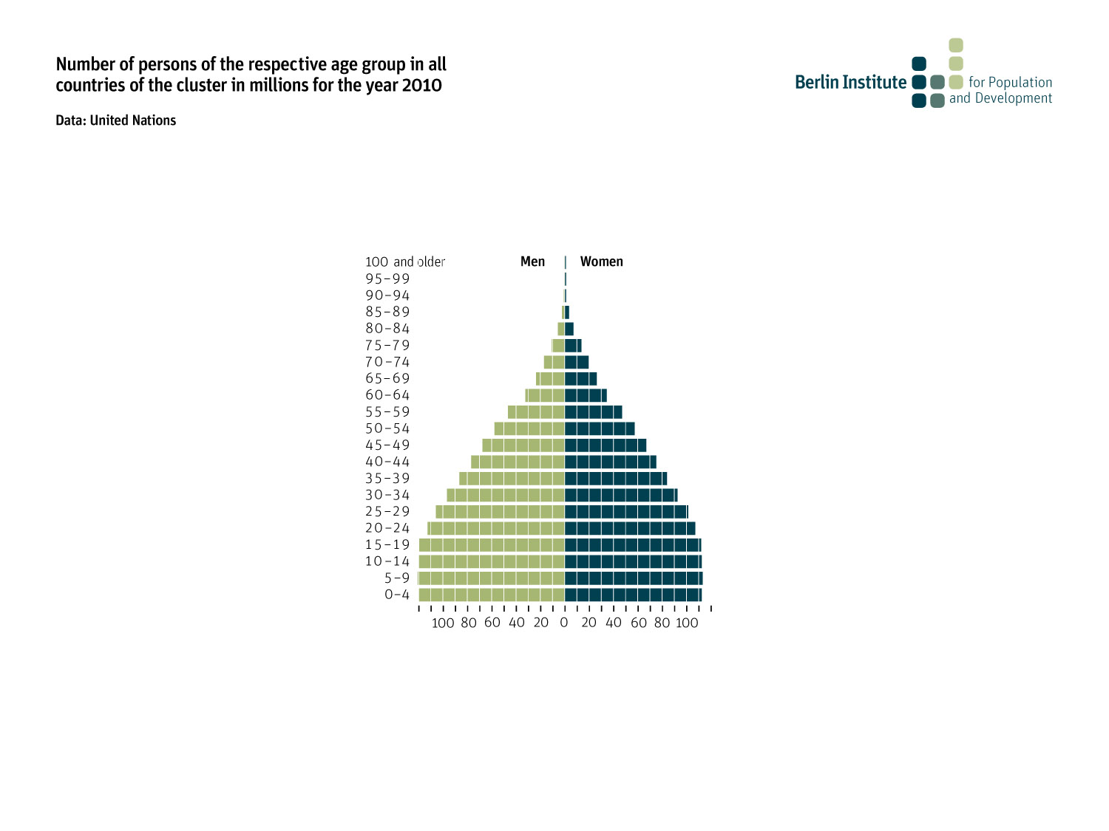
Cluster B
Cluster B
Cluster B

Slide 10
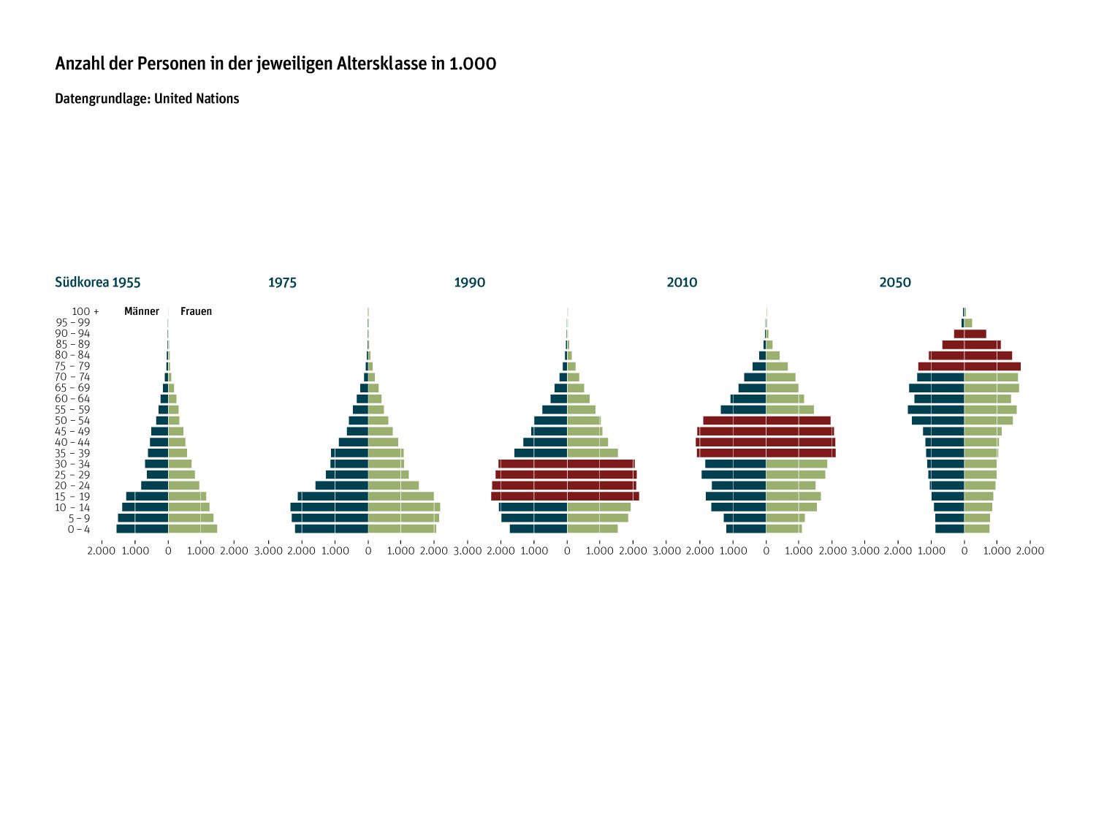

Number of inhabitants in South Korea according to age groups, numbers in 1.000
Data: United Nations
Men
Women

Slide 11
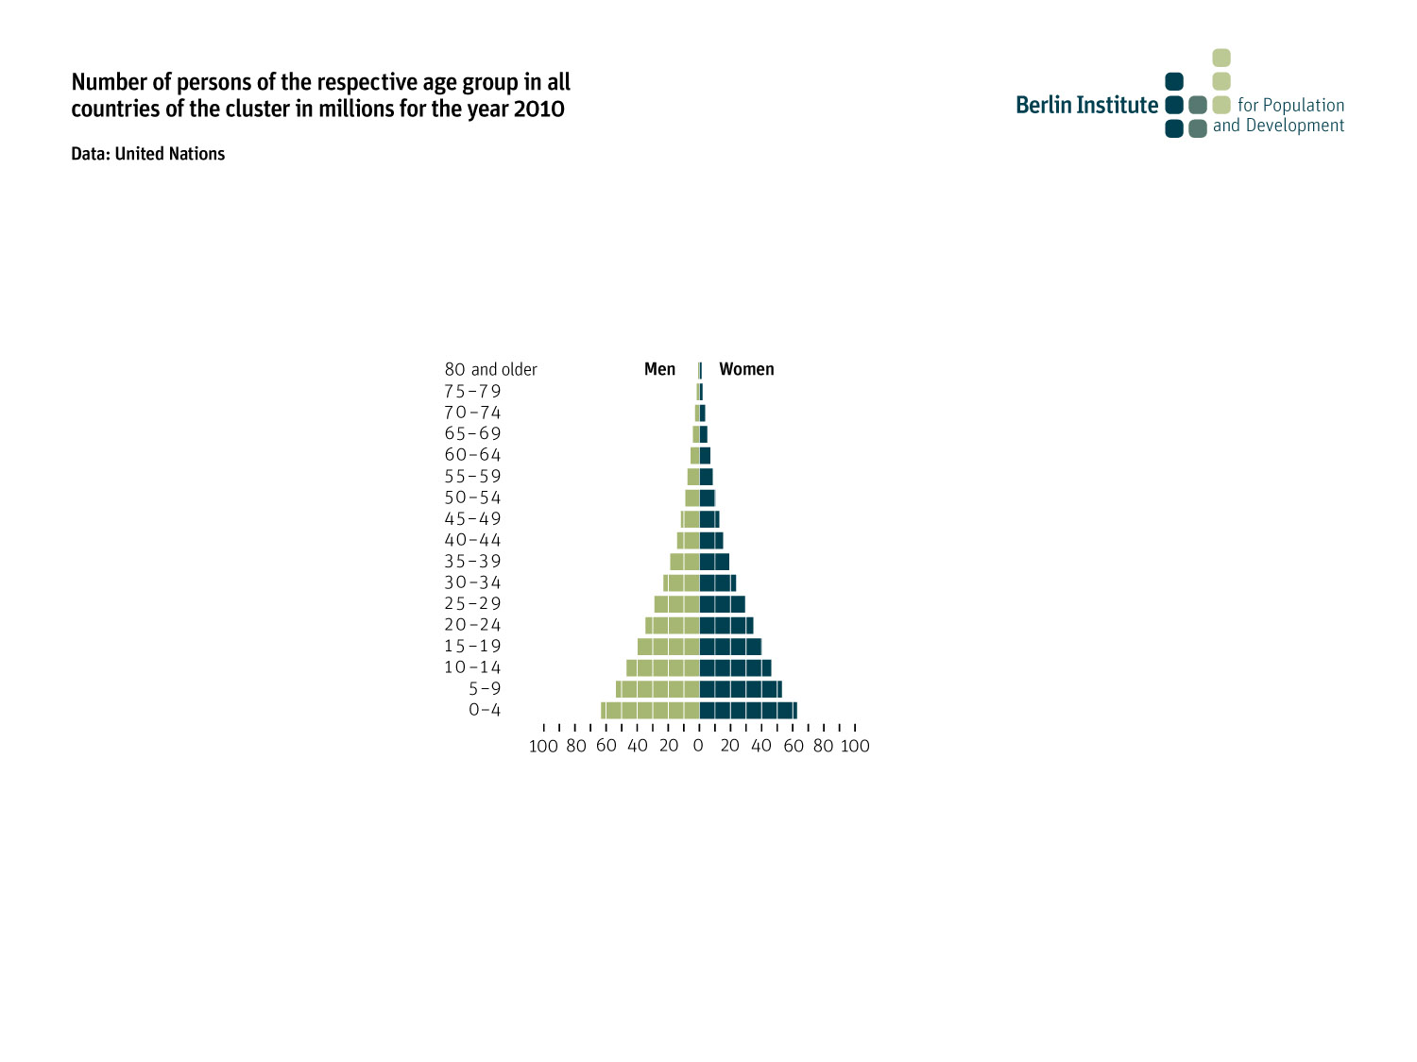
Cluster D

Slide 12
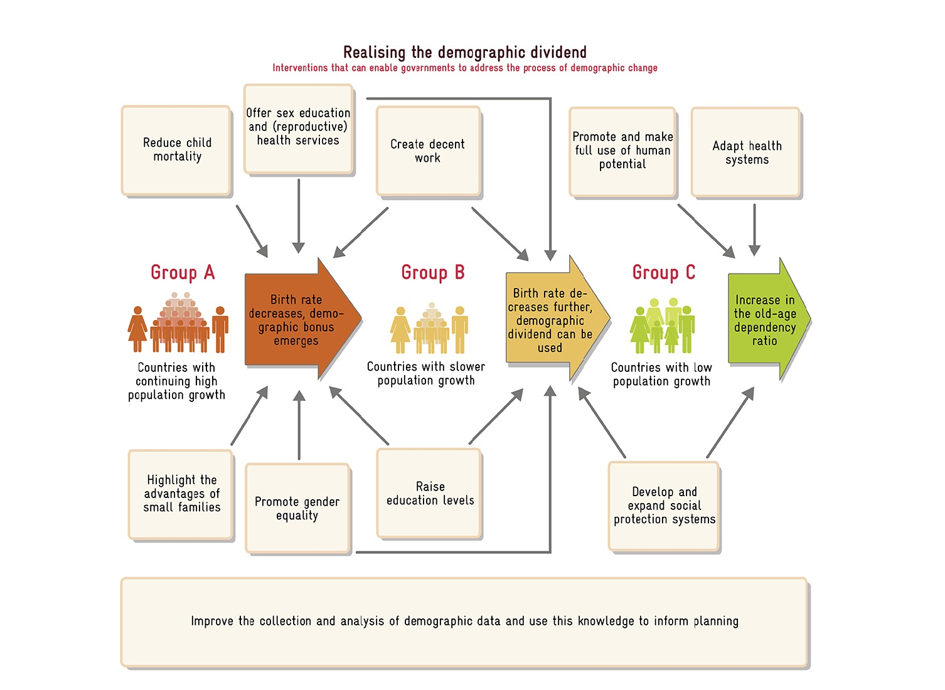

Slide 15
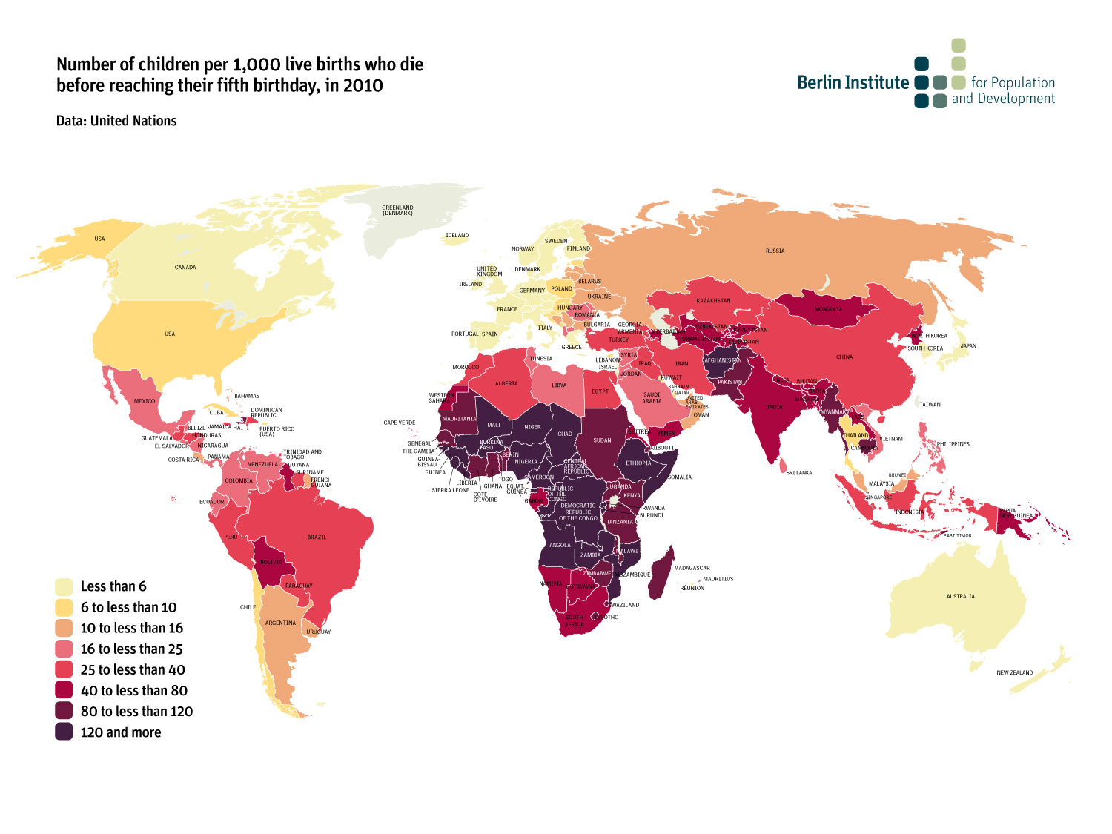

Slide 17
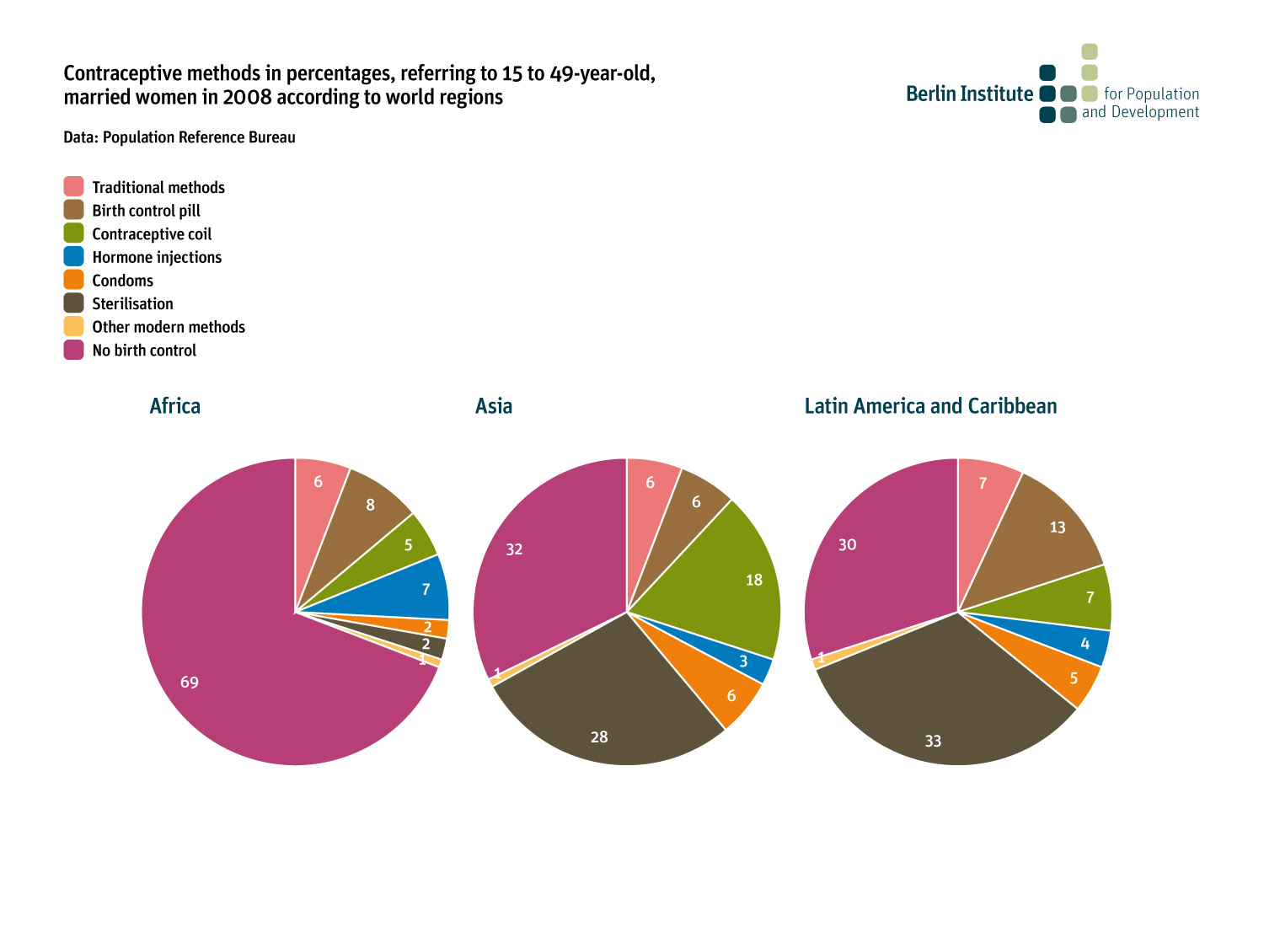

Slide 19
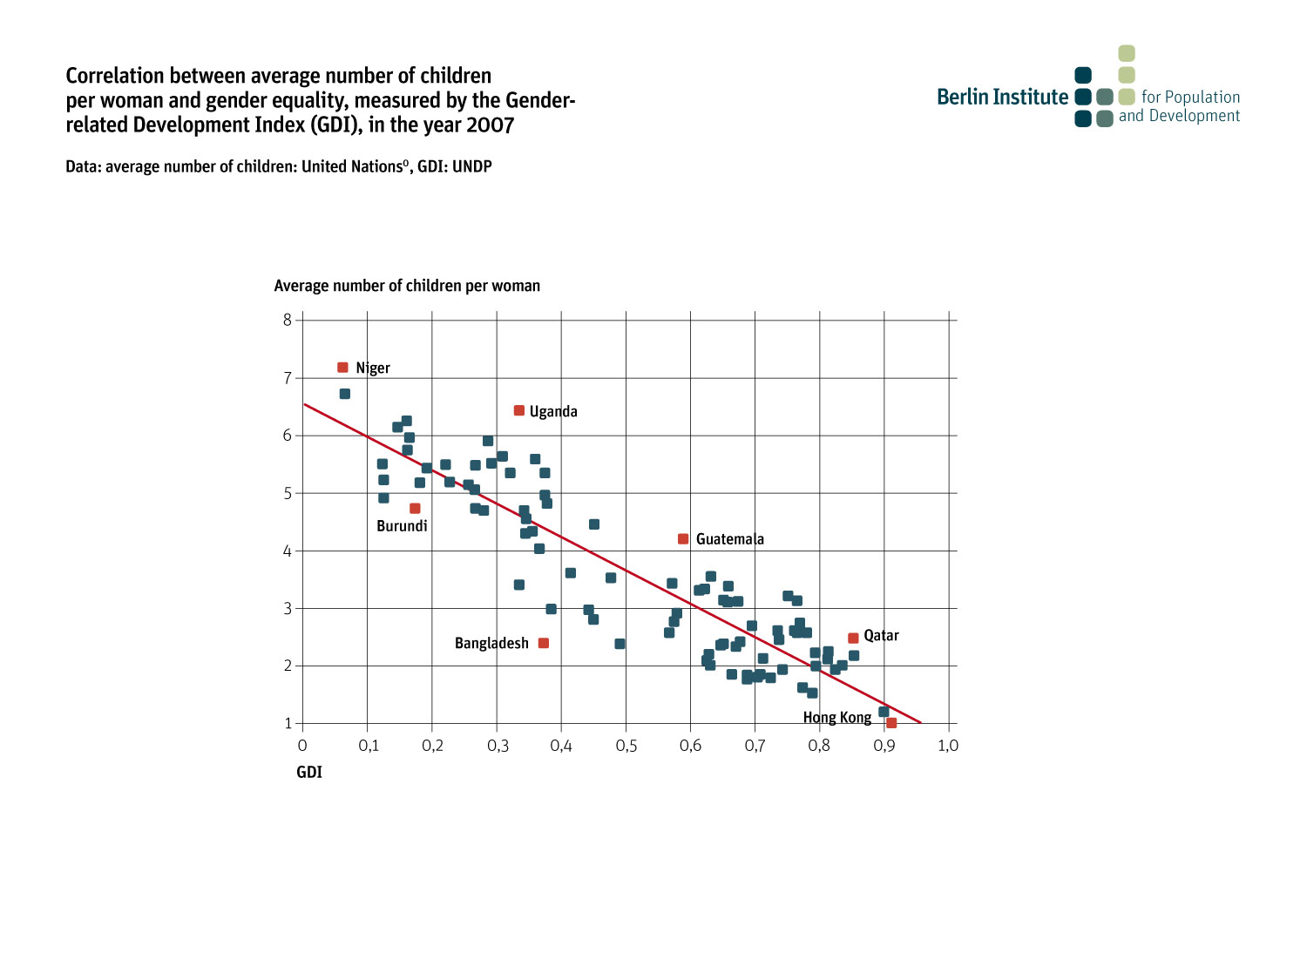

Slide 21
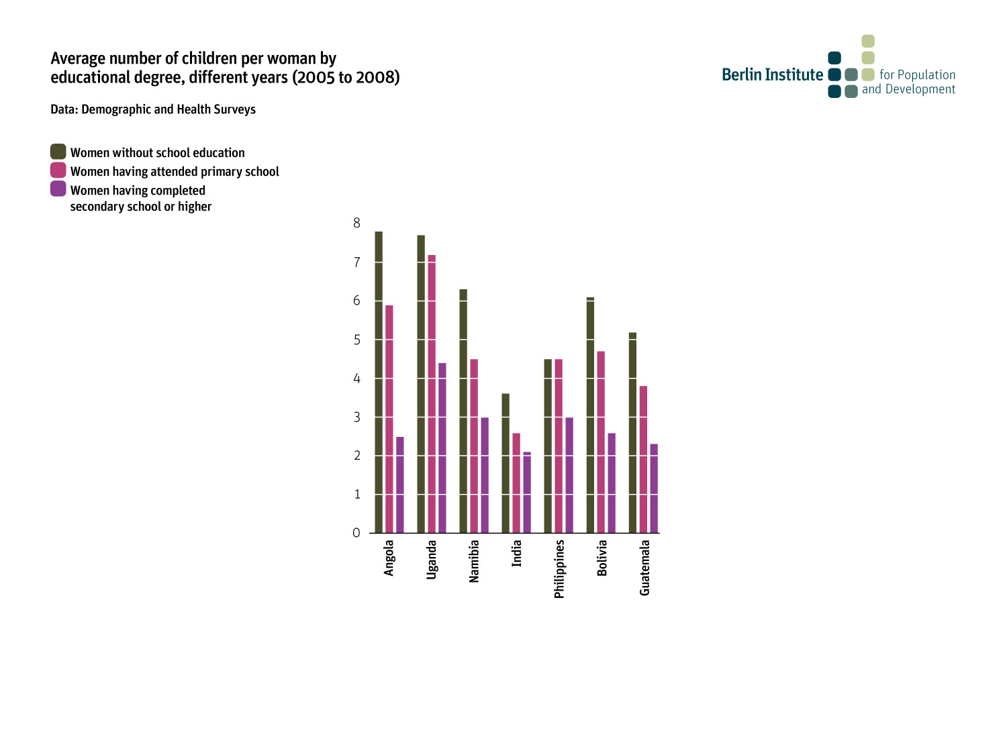

Slide 24
Number of inhabitants in South Korea according to age groups, numbers in 1.000
Data: United Nations
Men
Women

Slide 27
www.berlin-institut.org

